Slide 1
Interactive Analysis of Word Vector Embeddings
By F. Heimerl and M. Gleicher; (EuroVis) 2018
Presented by Skylar Wurster

Slide 2
Overview
Word embeddings are useful because they are able to encode word relationships within the vector space.
Viewing and understanding these encoded grammatical and semantic relations can be challenging.
The authors propose interactive designs that address tasks that domain experts have.
User feedback as well as example use cases are provided in the end.

Slide 3
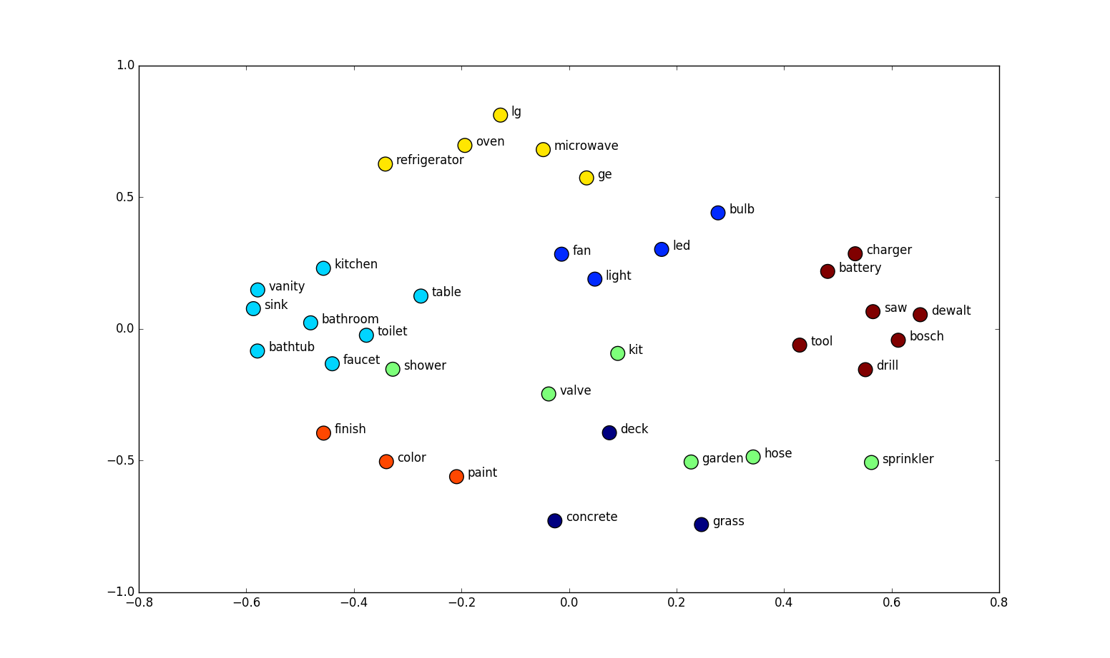
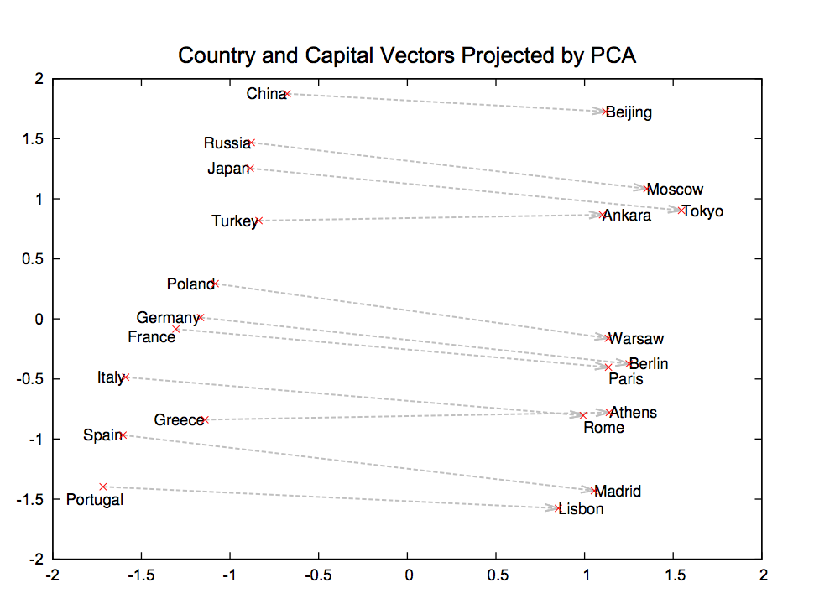
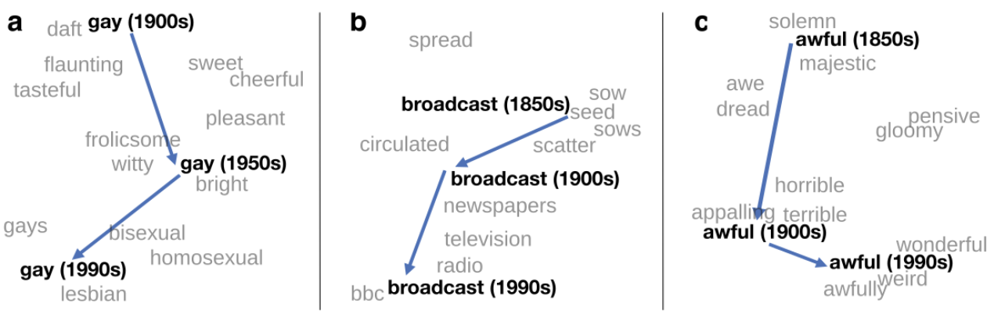
Word Embeddings
Unsupervised – tokenize a dataset and use a co-occurrence matrix based on a sliding window of size X to determine similarity.
Two lower dimensional matrices are factored from the first one with a vector for each word. One is the word vector matrix, the other is the context matrix, but is often discarded (though useful during analysis).

Slide 4
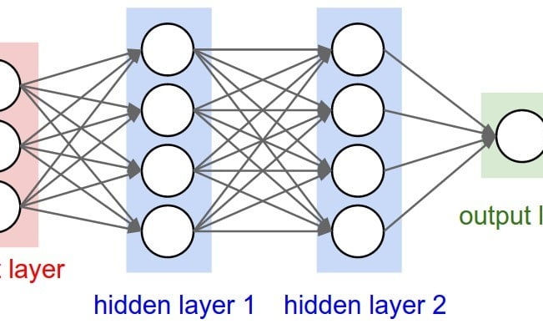
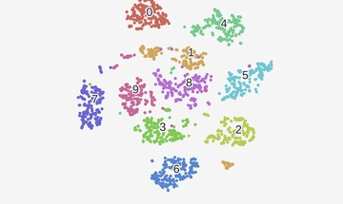
Model Visualization
Many visualizations exist (decision trees, EnsembleMatrix) but do not assist to evaluate the quality of the model created. Another visualization through dimensionality reduction, t-SNE, is popular but the authors found it not useful.
A popular word embedding technique is Word2Vec, which uses a neural network to create the embeddings. The authors don’t with to visualize a neural network though.

Slide 5
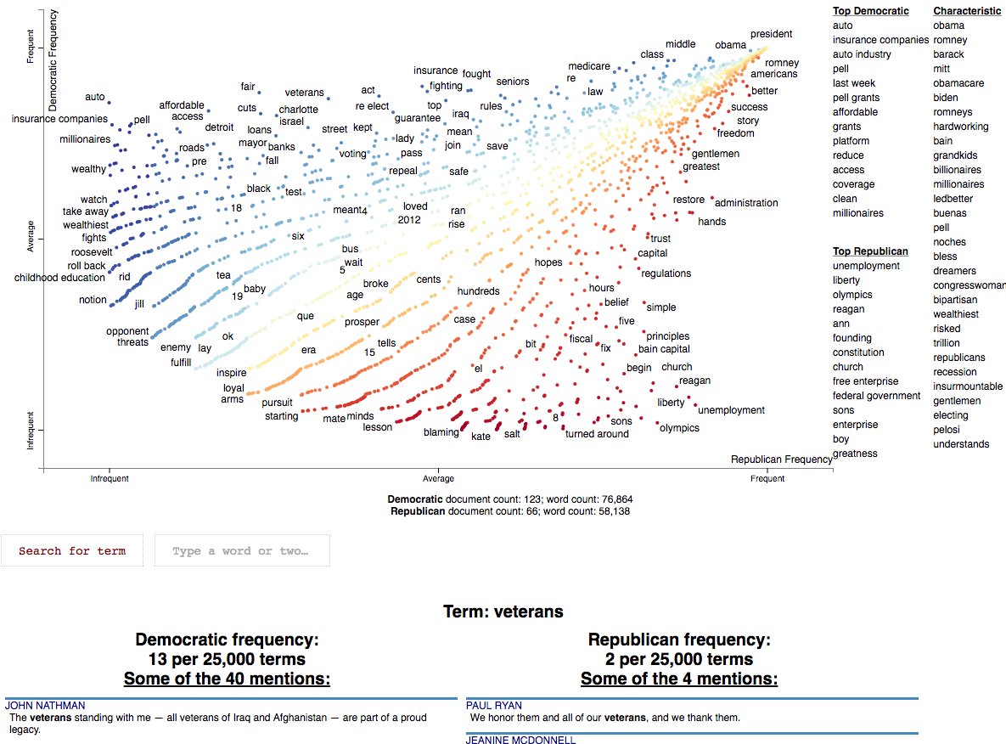
Text Visualization
Many solutions exist to visualize text given a particular task
E.g. Comparing two corpora based on word frequencies, visualizing hierarchical semantic relations between prominent words in a text, exploring levels of detail based on a variation of the excentric labeling technique, etc.
These all miss the mark of visualizing the word embeddings and co-occurrence patterns. Strategies such as PhraseNets and ConceptVector begin to work with visualizing the embeddings, but use the embeddings to analyze text data instead of the embeddings themselves.

Slide 6
Task Analysis
Literature from the NLP community and related fields are used to create tasks, and use a set of papers from the Association for Computational Linguistics (ACL) for primary publication sources for word imbedding literature.
111 papers surveyed from NLP, datamining, Human computer interaction, and more.

Slide 7
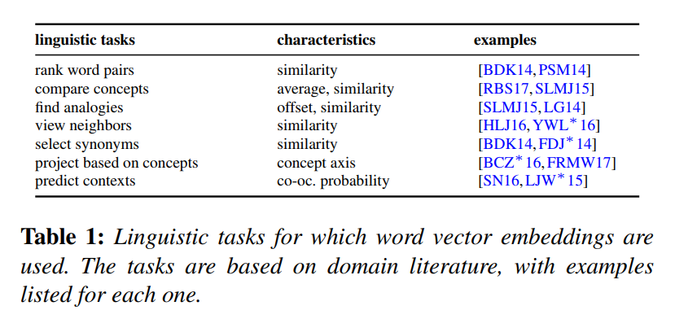
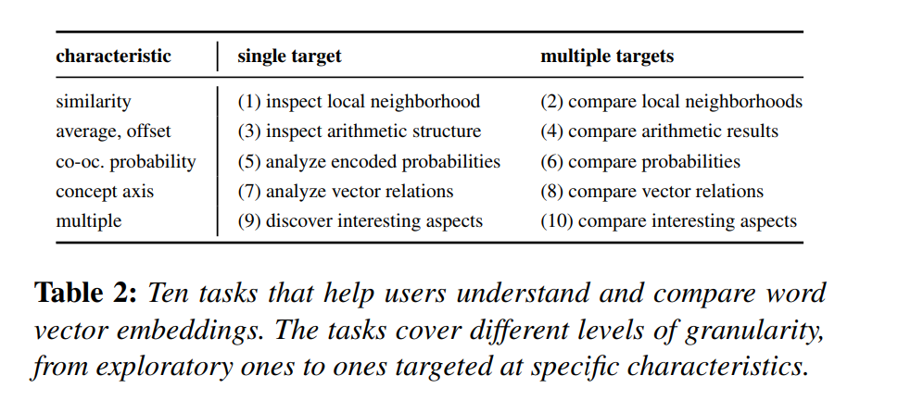
Linguistic Tasks for Word Embeddings
Evaluating embeddings is difficult because there is no ground truth answer. Therefore, extrinsic and intrinsic evaluation methods are used.
Extrinsic evaluation: Determines quality of a word embedding based on its application scenario in language processing
“If it works well for our use case, then it’s a good word embedding.”
Intrinsic evaluation: Determines quality of a word embedding based on the usefulness of the encoded relations by comparing them to known word relations
May be based on semantic similarity of words or analogy relations. Closest to “ground truth” as this gets.

Slide 8
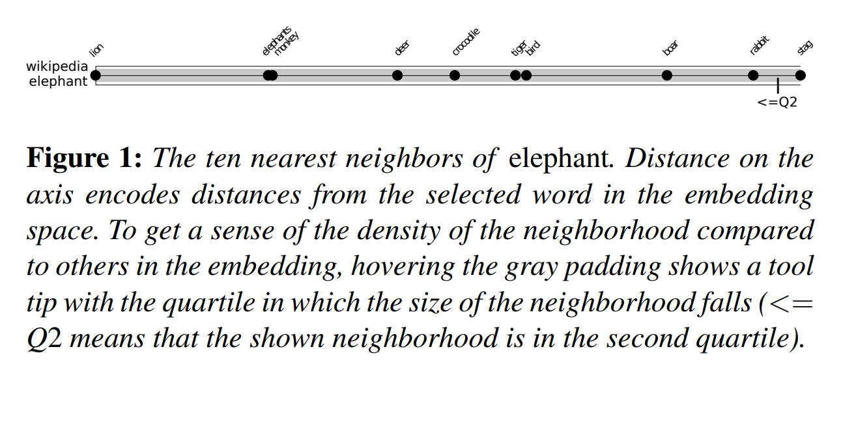
Local Neighborhoods – single
Task objective: view closest neighbors of a vector and understand the relative distances
2D projection methods might form a helpful scatter plot for nearest neighbors, especially MDS. But it remains unclear how much of the visible neighborhood structure is noise.
Solution: 1D plot with cosine distance used, as it is the most common choice in the literature
Distances to the chosen word are represented accurately, but distances between neighbors are not.
Gray background indicating quartile shows how meaningful the neighborhood relationship is.

Slide 9
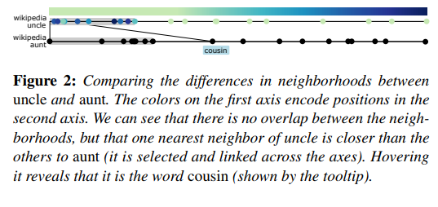
Comparing neighborhoods - multiple
Two 1D plots are stacked on top of each other, both with a chosen word and their nearest neighbors.
Interaction: selecting a word (dot) on either plot shows the selected word on the other plot by connecting across the plots. Then, it colors the words on that other plot by the cosine distance to the selected word.

Slide 10
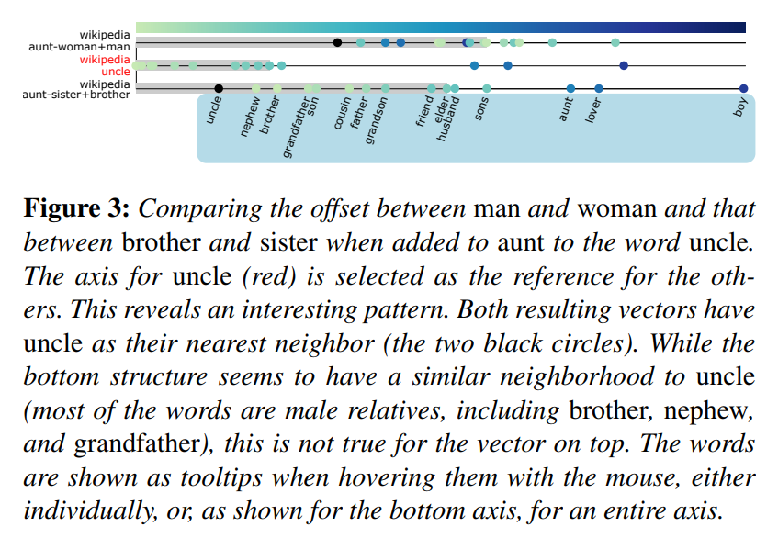
Comparing neighborhoods – multiple
Custom vector computations can be created to compare to each other and to a baseline vector (uncle, in this case)

Slide 11
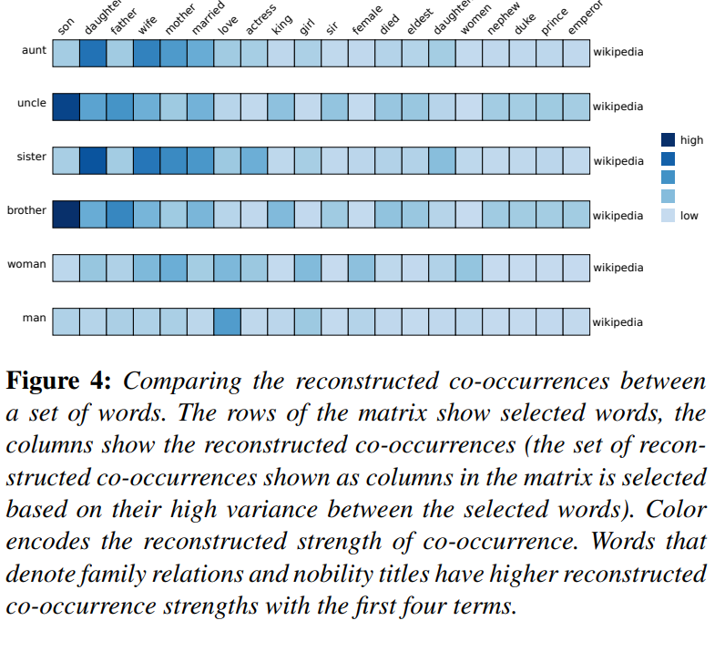
Co-occurrence patterns - Single
Useful when the embedding is used for context prediction, as well as for understanding the underlying corpus.
While a direct co-occurrence matrix can be used, an approximate matrix can be extracted from the embeddings and can help to debug.
A matrix visualization is used here, with the rows being a set of words selected by the user.

Slide 12
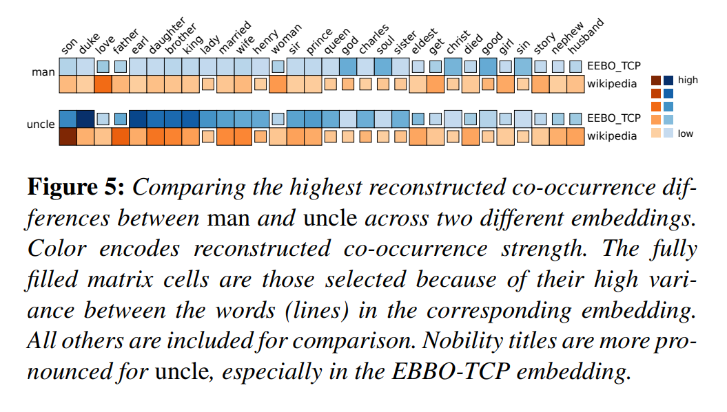
Co-Occurrence Patterns - multiple
Similar to the single embedding co-occurrence. Now, each embedding has one hue, and lightness (intensity) is used to represent co-occurrence strength.
Since each embedding will have different co-occurrence values, the union set of the n strongest embeddings will show on top. If one embedding does not have a word in it’s top n, then the box will be reduced in size.
NOTE: area is typically better for continuous values, but represents a binary value here. The authors note that using area instead of an intensity gradient caused the matrix to look misshaped and discontinuous.

Slide 13
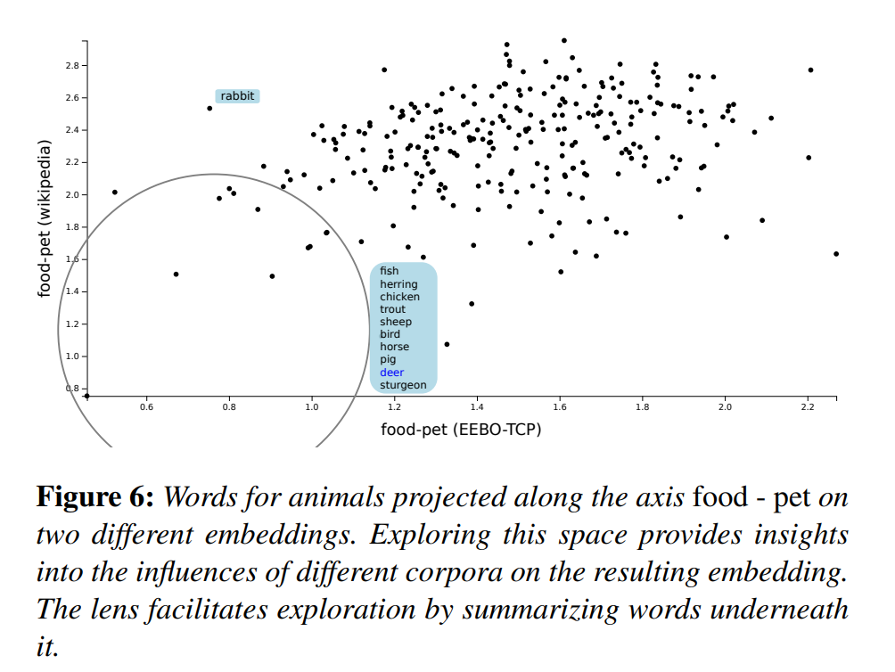
Mapping to concept axes
Users may select their own concept axes from their embeddings. Here “food-pet” is the concept taken from two embeddings.
User selects a set of embeddings to add to the scatterplot.
A magic lens is available to view items within the circle, and hovering a mouse over a point will tell the user it’s word.
Embeddings closer to bottom are closer to the food concept in the Wikipedia embeddings, and those to the left are closer to food in the EEBO-TCP embedding. Words in the top and right of the plot are close to the pet concept in the respective embedding

Slide 14
Implementation
Backend:
Python3.6
GloVe and word2vec
Flask web framework
Frontent:
D3.js
jQuery UI
Challenges:
Interactive response time – specifically for the lens
Quadtree used to speed up processing for a given 2D projection

Slide 15
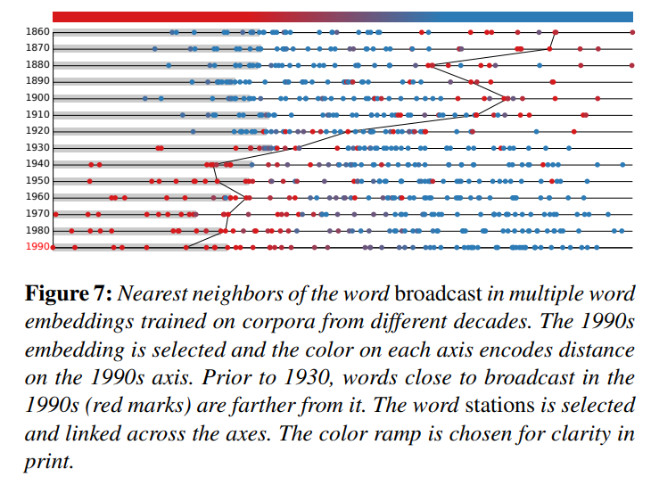
Use case: Changes on Word Meaning
Create embeddings for each decade from 1800 to 1990 using the English Google Ngram corpus using skip-gram word2vec
Focus on “broadcast” and its change.
Denoted sowing a field by scattering seeds until 20th century
Radio technology changes its meaning to distribution of information through electromagnetic waves
Major change in 1920s

Slide 16
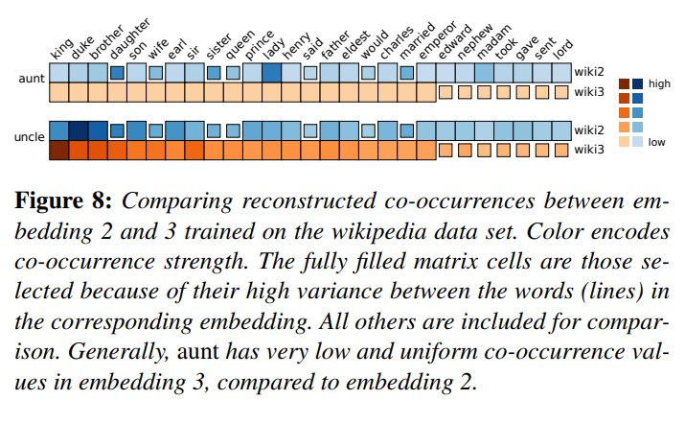
Use Case: Stability of Embeddings
A concern with word embeddings is the non-determinism of the embedding methods, causing unstable neighborhoods.
Five embeddings are created using GloVe with a window size of 15 and compared.
Comparing them shows that embedding 3 is an outlier, as 1, 2, 4, and 5 have nearly identical neighborhoods for uncle
Investigating further, aunt has the same issue in embedding 3 as uncle.

Slide 17
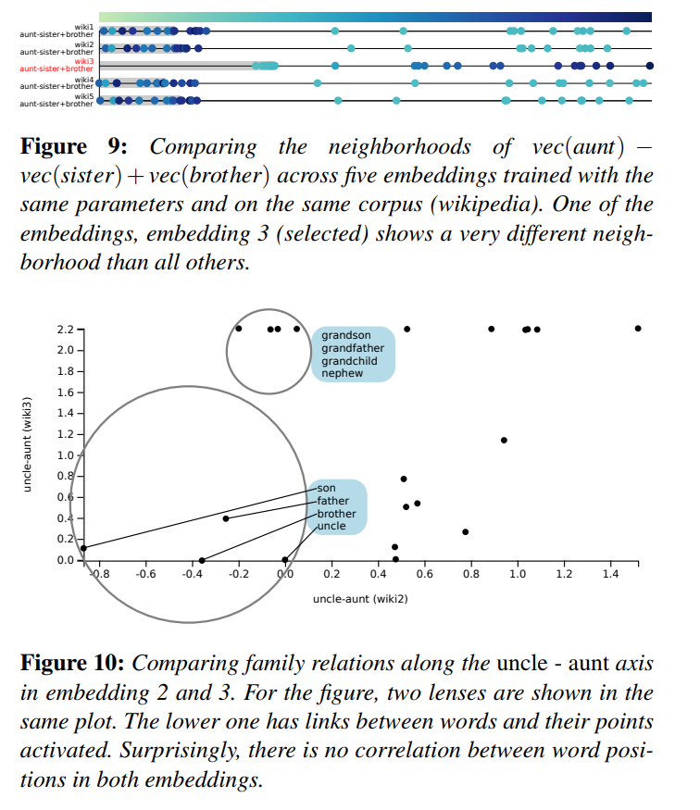
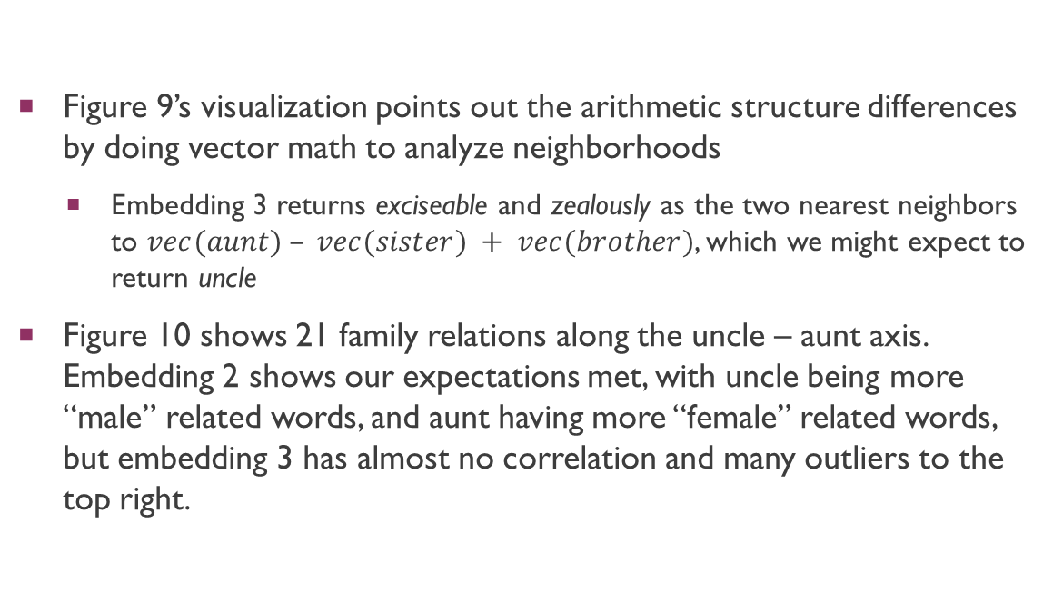
Use Case: Stability of Embeddings – cont.
Figure 9’s visualization points out the arithmetic structure differences by doing vector math to analyze neighborhoods
Embedding 3 returns exciseable and zealously as the two nearest neighbors to $vec(aunt) – vec(sister) + vec(brother)$, which we might expect to return uncle
Figure 10 shows 21 family relations along the uncle – aunt axis. Embedding 2 shows our expectations met, with uncle being more “male” related words, and aunt having more “female” related words, but embedding 3 has almost no correlation and many outliers to the top right.

Slide 18

Domain expert feedback
Three experts – two active literary researchers with interest but no experience with word embeddings and one NLP researcher working on embedding algorithms.
One of the literary scholars had prior experience with programming and computer science
Both groups found neighborhood comparison useful
Literary experts had more interest in concept axes
NLP researcher’s focus was on the reconstructed co-occurrence matrix visualization, and specifically mentioned it was useful for debugging and comparing multiple embeddings.

Slide 19

Future Work
Identifying appropriate words, synonym groups and analogies
Structures in the embedding, such as densely clustered words or salient vector offsets that may contain meaning
Comparing these structures between embeddings
Using these embedding techniques on other types of embeddings
Images, videos, graphics

